Slide 1



TITLE
ABOUT
CONTENT
OTHERS
Gideon
AI ASSISTANT FOR FINANCE AND ACCOUNTING
382054 | Arnav Gilankar | 22311644
382024 | Manaswi Shekokar | 22310637

Slide 2


HOME
ABOUT
CONTENT
OTHERS
Problem Statement
Finance teams spend 60 to 70% of their time on manual tasks, such as data entry, expense categorization, document processing, and report generation. This leaves less time for strategic analysis. Traditional systems do not have smart automation and need technical skills to pull insights from financial data.
Key challenges :
Document processing inefficiency - static repositories requiring manual search and review
Limited accessibility to financial insights - requires complex queries and technical skills
Manual bottlenecks in month-end closing, and expense management

Slide 3
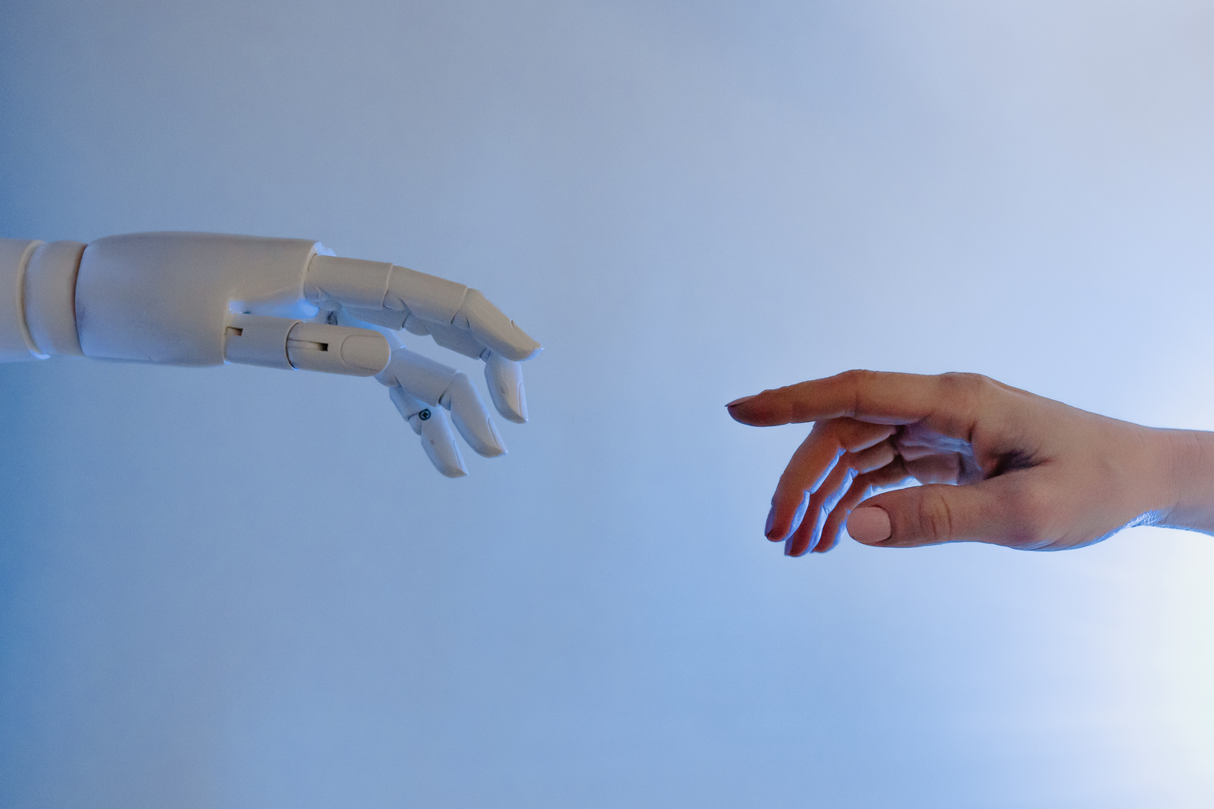
HOME
ABOUT
INTRODUCTION
OTHERS
Recent advances in agentic AI and deep learning provide breakthrough solutions for automated finance and accounting operations. Traditional automation improves efficiency and accuracy, but it often fails to provide adaptive insights or smooth integration within complex business workflows. AI agents, powered by domain-specific LLMs, fill these gaps by constantly learning financial context and interacting naturally with business data. However, they need careful orchestration and integration with essential systems.
Existing techniques:
Manual bookkeeping and reconciliation by finance teams
Tipalti AI (Invoice capture, fraud detection, coding automation)
Trullion AI (Contextual compliance review, vertical agentic chatbots)
This project is an AI finance and accounting assistant that works with Odoo ERP. It uses Llama 3.1 (8B) with RAG to answer questions, analyze documents like PDF, Excel, Word, and CSV, and automate tasks such as expense analysis, sales analysis, and adding tables into ERP modules and the Odoo database.

Slide 4
HOME
ABOUT
LITERATURE SURVEY
OTHERS
Paper Title | Publisher | Publish date | Methodology | Results | Gap | Summary
Innovative Applications of Artificial Intelligence in Accounting and Financial Management | Frontiers in Management Science | 2024-12-01 | Literature review combined with case analysis and analysis of third‑party data | AI offers benefits in automating accounting processes, enabling intelligent auditing, and improving financial forecasting and analysis | Technical compatibility, management shifts, data security, privacy, legal compliance; requires further work and policy guidance. | Highlights AI's potential to improve financial management, with recommendations for integration, security, and compliance.
Intelligent Accounting Information Systems in Corporate Financial Management: Application and Challenges | Journal of World Economy | 2024-12-01 | Qualitative synthesis using literature review, case analysis, and third‑party datasets | IAAIS enhance automated accounting, real‑time reporting, budgeting, risk control, and cost optimization | Technical integration, management change, security, training, compliance; offers recommendations and research directions. | IAAIS enables digital financial transformation, highlighting technical, organizational, and regulatory challenges needing strategies and research.

Slide 5
HOME
ABOUT
LITERATURE SURVEY
OTHERS
Paper Title | Publisher | Publish date | Methodology | Results | Gap | Summary
Driving Efficiency and Risk Management in Finance through AI and RPA | Preprint server (DOI: 10.20944/preprints202407.0083.v1) | 2024-07-01 | Review and analytical discussion of AI and RPA integration in financial accounting and management | AI+RPA boost efficiency, accuracy, and cost-effectiveness in finance; RPA faces challenges with unstructured data and complex decisions. | RPA struggles with unstructured data and complex decisions; cloud scaling and further technical work needed. | Explores AI and RPA for corporate finance efficiency and risk management, noting RPA limits and digital transformation drivers.
Artificial Intelligence Applications in Accounting and Finance | IEEE Conference Proceedings (DOI: 10.1109/icetsis61505.2024.10459526) | 2024-01-28 | Review of AI applications in accounting and finance, showcasing use cases and diverse techniques. | AI streamlines financial processes, automates audits and taxes, supports decision-making, and enhances reliability and efficiency. | Adoption barriers: implementation, data, and governance; provides use cases but no new performance metrics. | Maps AI tools in finance (expert systems, agents, NLP, RPA, blockchain, ML) and evaluates impacts on reliability and timeliness.

Slide 6
HOME
ABOUT
LITERATURE SURVEY
OTHERS
Paper Title | Publisher | Publish date | Methodology | Results | Gap | Summary
Automation and the Future of Accounting: A Study of AI Integration in Financial Reporting | IEEE Conference Proceedings (DOI: 10.1109/ickecs61492.2024.10616967) | 2024-04-18 | Thorough literature analysis with comparative analysis and data‑driven outcomes | AI (NLP, ML, data analytics) transforms data interpretation and decision making in accounting and offers comparative performance insights | Concerns about data privacy, algorithmic bias, and human role displacement; recommends policy and corporate guidance | Consolidates literature on AI in financial reporting, contrasts technology performance qualitatively, and foregrounds ethical and governance questions that warrant empirical follow‑up

Slide 7

HOME
ABOUT
METHODOLOGY
OTHERS
For deploying our AI finance assistant, we used Docker to deploy the Odoo system. Inside the odoo container, we installed Ollama to run Llama 3.1 (8B) and set up a PostgreSQL database to manage ERP data. This setup ensures we can scale, move, and integrate smoothly with the Odoo environment.
Llama 3.1 (8B)
Retrieval-Augmented Generation (RAG):
Functionalities
used for its efficiency and accuracy in financial text understanding, enabling natural language interaction with ERP data
Ensures context-aware responses by retrieving semantically relevant chunks from documents, overcoming LLM’s knowledge limitations.
Document analysis, table-to-ERP processing, query answering, and AI-powered expense & product sales analysis.

Slide 8
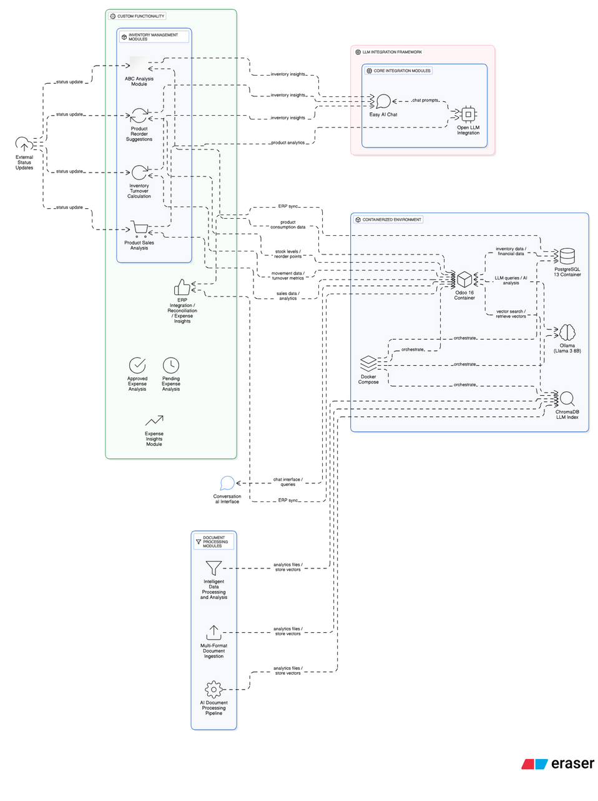
ARCHITECTURE OF PROJECT

Slide 9
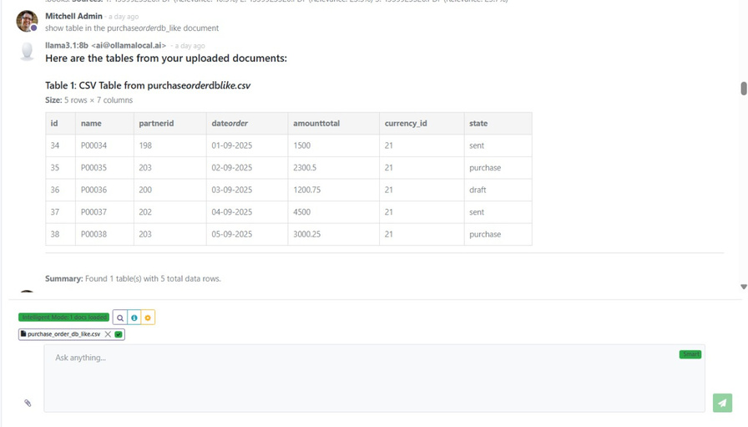
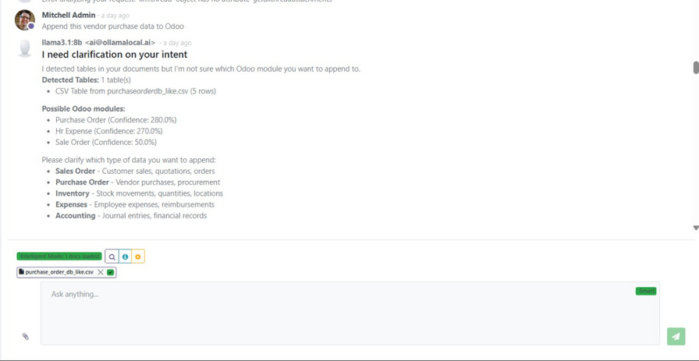
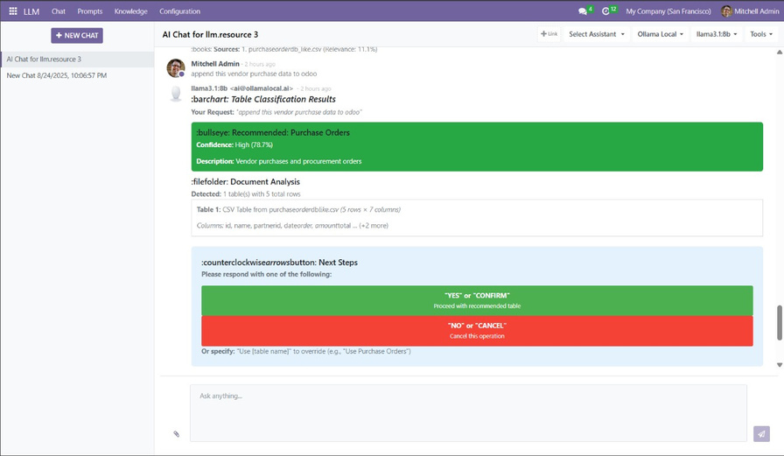
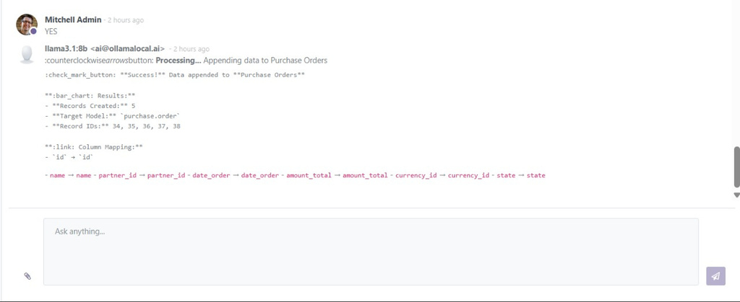
HOME
ABOUT
RESULTS
OTHERS
Fig.1. Uploading Document and retreiving information and analysis
Fig.2. Deciding in which the data should be appended
Fig.4. Data Successfully appended
Fig.3. Confirming to append the data into database

Slide 10
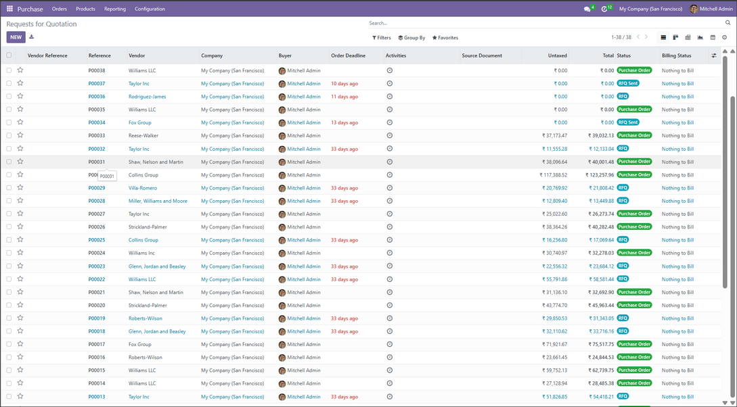

HOME
ABOUT
RESULTS
OTHERS
Fig.5. Purchase database
Fig.6. Modified Database

Slide 11
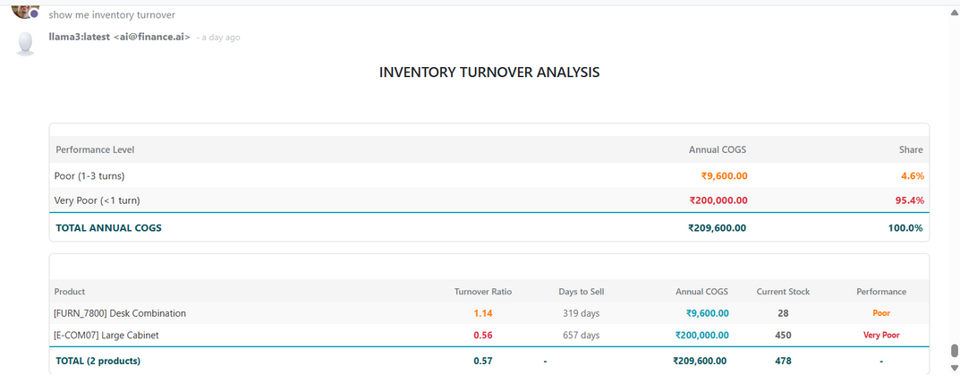
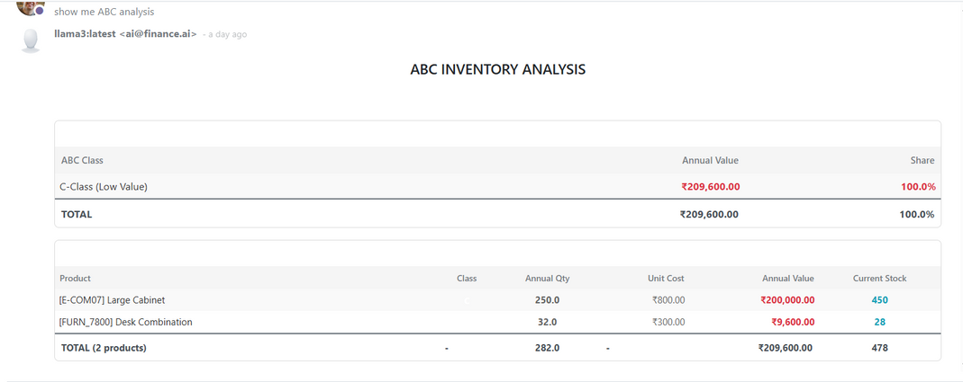
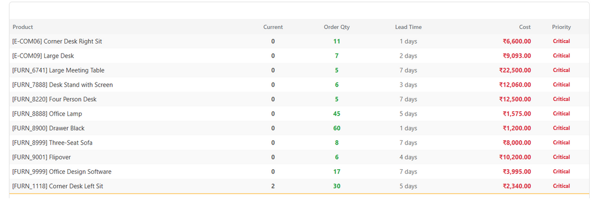
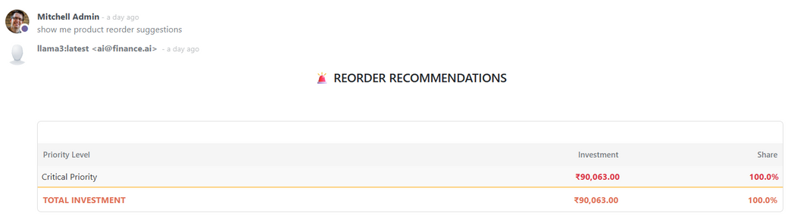
HOME
ABOUT
RESULTS
OTHERS
Fig.7. Turnover calculation of Products
Fig.8. ABC classification Analysis
Fig.9. Product Reorder Suggestions
Fig.10. Product Reorder Suggestions

Slide 12
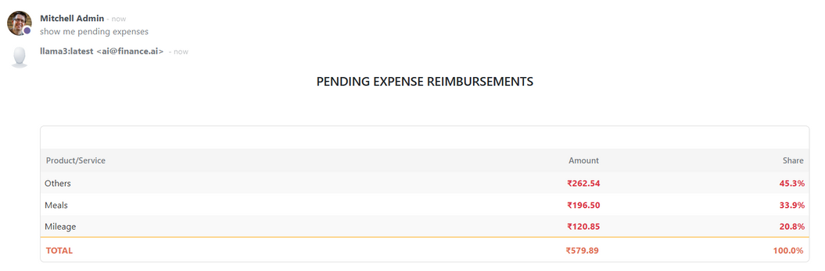
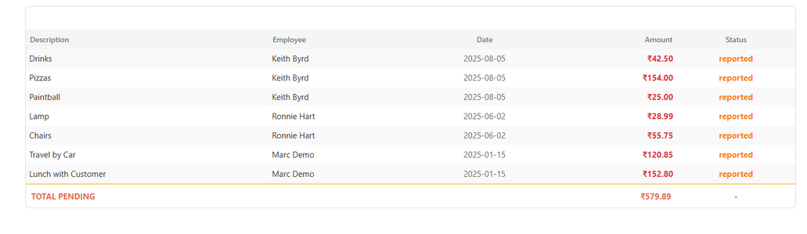
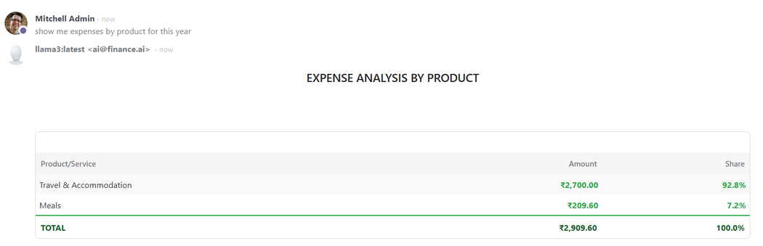
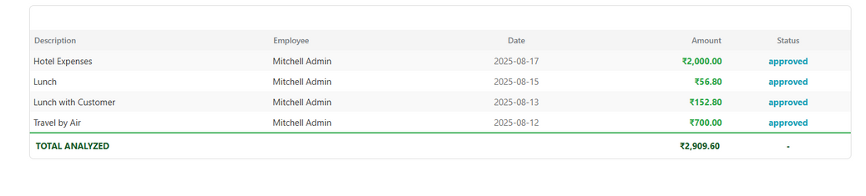
HOME
ABOUT
RESULTS
OTHERS
Fig.11. Pending Expenses Analysis
Fig.12. Products with Pending Expense Records
Fig.13. Products with Approved Expense Analysis
Fig.14. Products with Approved Expense Records

Slide 13
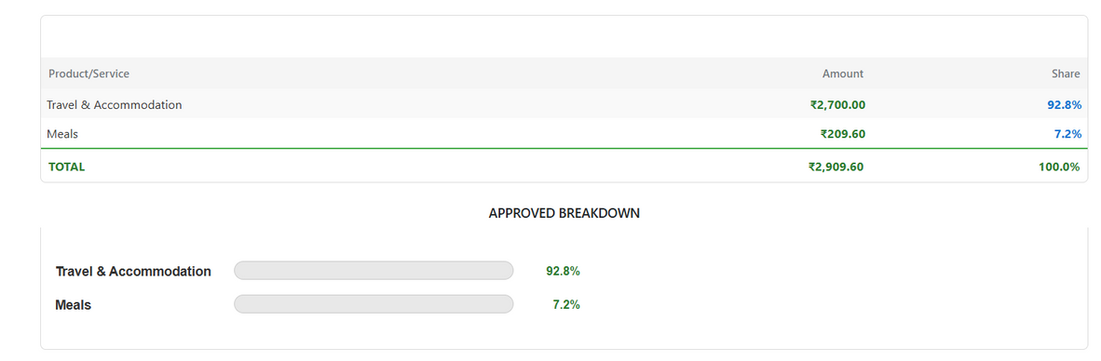
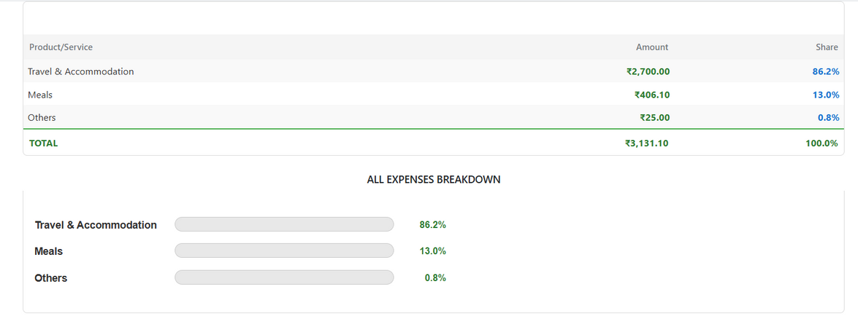
HOME
ABOUT
RESULTS
OTHERS
Fig.15. Expense Insights for Approved Expenses
Fig.16. Expense Insights for All Expenses

Slide 14
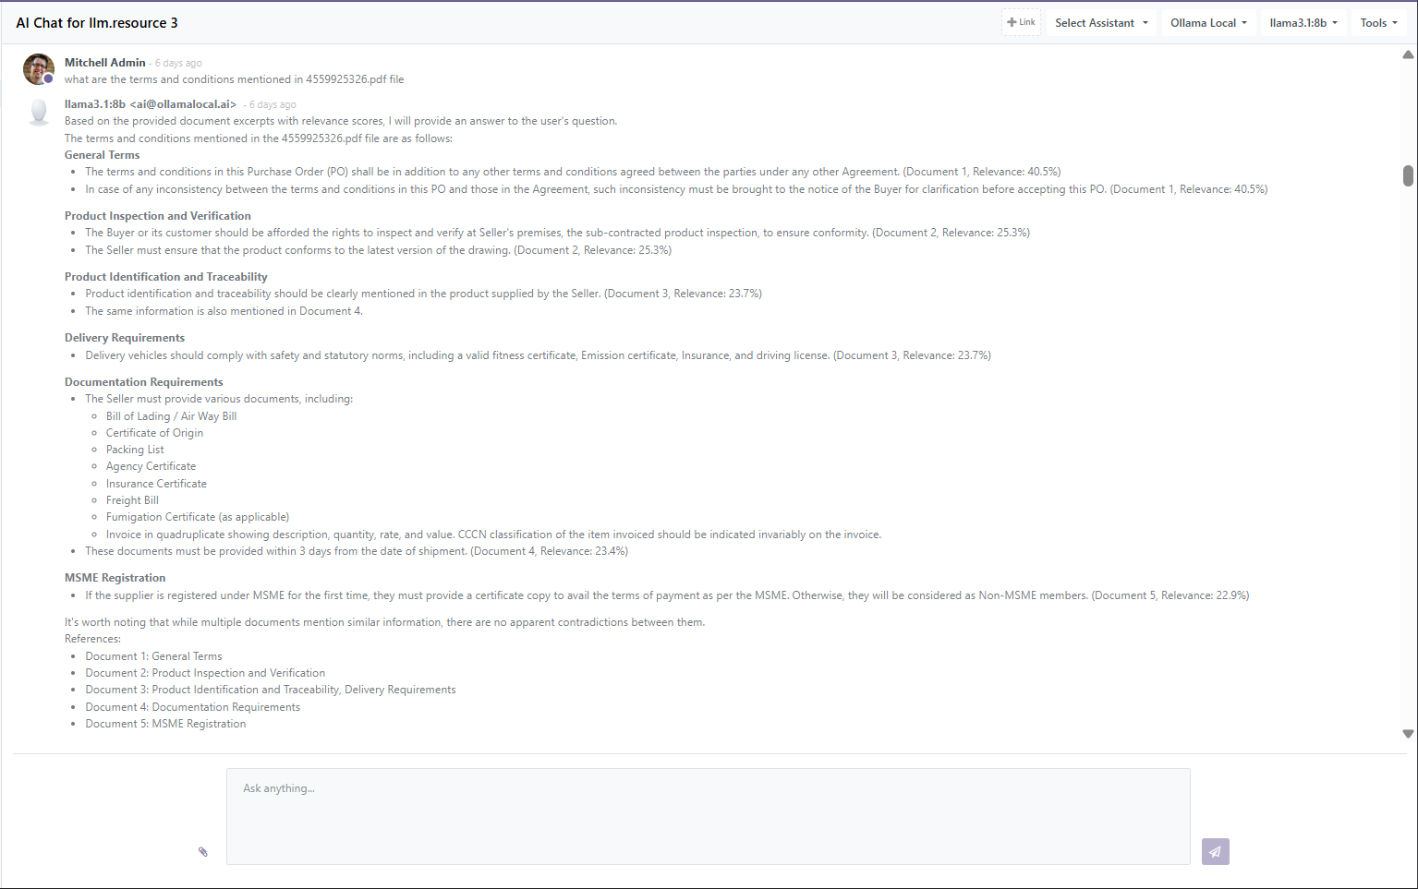

HOME
ABOUT
RESULTS
OTHERS
Fig.17. RAG response

Slide 15
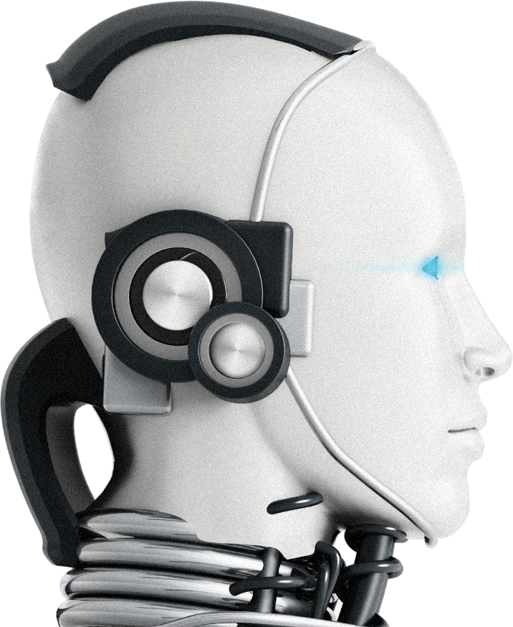

HOME
TECH STACK
CONTENT
OTHERS
BACKE
Backend
DataBase
LLAMA 3 .1: 8B
RAG
NLP
POSTGRESGL
CHROMADB
Software
Libraries
ODOO 16
PANDAS
NUMPY
MATH
STATISTICS
PYPDF2,
PDFPLUMBER,
PYTHON-DOCX,
OPENPYXL
Programming Language
PYTHON, XML, JS

Slide 16
HOME
ABOUT
COMPARATIVE ANALYSIS OF MODELS
OTHERS
Paper | Focus | Key Contribution
Liu (2024) | AI in Accounting & Financial Mgmt. | Innovative AI use in fraud detection, auditing, forecasting.
Rahim & Chishti (2024) | AI in Accounting & Finance | Broad review of ML, NLP, robotics in finance, efficiency insights.
Kuaiber et al. (2024) | AI & Automation in Reporting | Demonstrates automation in financial reporting using AI.
Gideon | AI-powered ERP Integration | Combines LLM + RAG + Agentic AI inside Odoo: document analysis, semantic search, table-to-record automation across sales, purchase, HR, inventory, and expenses.

Slide 17
HOME
ABOUT
UNIQUENESS IN PROJECT
OTHERS
Seamless Odoo Integration – combines LLM + RAG directly into ERP workflows, not just standalone chat.
Agentic Capabilities – AI can not only answer but also act (e.g., append tables, create records, trigger workflows).
Adaptive RAG – relevance boosting, similarity scoring, and multi-model embeddings for more accurate retrieval.
End-to-End Automation – from reading business documents → extracting insights → creating ERP records.
Expense Analysis – Identifies, categorizes, and summarizes employee or product-related expenses.
Product Sales Analysis – Tracks stock movement, valuations, and product quantities for better decision-making.

Slide 18
HOME
ABOUT
FUTURE SCOPES
OTHERS
Adding voice-enabled interaction for hands-free operations.
Build task-specific agents (Finance Agent, HR Agent, Inventory Agent) for domain expertise and faster decision-making.
Introduce autonomous AI agents that can plan, decide, and execute multi-step workflows in Odoo (e.g., auto-approving expenses, creating purchase orders).
HOME
ABOUT
CONCLUSION
OTHERS
Integrates LLMs with Odoo for smart document processing.
Uses RAG + ChromaDB to retrieve relevant context from attachments.
Supports conversational AI within Odoo chat threads.
Automates table-to-record creation in sales, purchase, HR, inventory, and accounts.
Enhances productivity by converting unstructured data into actionable insights.

Slide 19
HOME
ABOUT
CONTENT
REFERENCES
[1]M. Liu, “Innovative Applications of Artificial Intelligence in Accounting and Financial Management,” Frontiers in Management Science, vol. 3, no. 6, pp. 67–75, Dec. 2024, doi: https://doi.org/10.56397/fms.2024.12.10.
[2]M. Liu, “Intelligent Accounting Information Systems in Corporate Financial Management: Application and Challenges,” Journal of World Economy, vol. 3, no. 4, pp. 85–94, Dec. 2024, doi: https://doi.org/10.56397/jwe.2024.12.10.
[3]R. Rahim and Mohammad Ahsan Chishti, “Artificial Intelligence Applications in Accounting and Finance,” Jan. 2024, doi: https://doi.org/10.1109/icetsis61505.2024.10459526.
[4]M. Q. Kuaiber, Z. N. Ali, A. J. Al-Yasiri, A. J. Kareem, M. A. Al, and A. Almagtome, “Automation and the Future of Accounting: A Study of AI Integration in Financial Reporting,” 2024 International Conference on Knowledge Engineering and Communication Systems (ICKECS), vol. 30, pp. 1–6, Apr. 2024, doi: https://doi.org/10.1109/ickecs61492.2024.10616967.

Slide 20
Thankyou
Next Slide
ANY QUESTIONS ??

